Slide 1
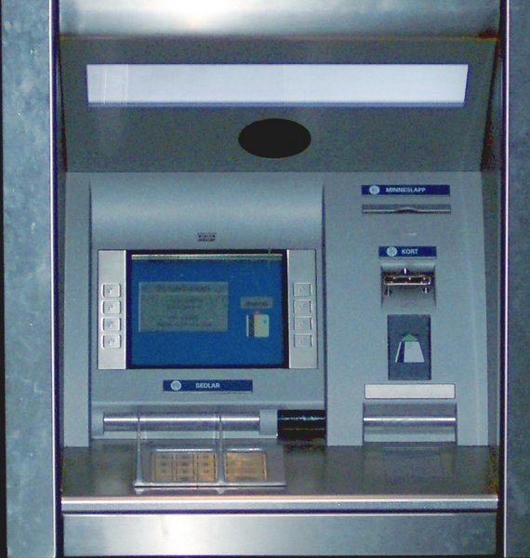
Example: bank balance
Protect shared variable balance with a semaphore when used in:
  decshared
    Decrements current value of balance
  incshared
    increments the balance
Copyright ©: University of Illinois CS 241 Staff

Slide 2
Example: bank balance
int decshared() {
while (sem_wait(&balance_sem) == -1)
if (errno != EINTR)
return -1;
balance--;
return sem_post(&balance_sem);
}
int incshared() {
while (sem_wait(&balance_sem) == -1)
if (errno != EINTR)
return -1;
balance++;
return sem_post(&balance_sem);
}
Copyright ©: University of Illinois CS 241 Staff

Slide 3

Example: bank balance
#include <errno.h>
#include <semaphore.h>
static int balance = 0;
static sem_t bal_sem;
int initshared(int val) {
if (sem_init(&bal_sem, 0, 1) == -1)
return -1;
balance = val;
return 0;
}
pshared
value
Copyright ©: University of Illinois CS 241 Staff

Slide 4
Example: bank balance
int decshared() {
while (sem_wait(&bal_sem)
== -1)
if (errno != EINTR)
return -1;
balance--;
return sem_post(&bal_sem);
}
int incshared() {
while (sem_wait(&bal_sem)
== -1)
if (errno != EINTR)
return -1;
balance++;
return sem_post(&bal_sem);
}
Which one is going first?
Copyright ©: University of Illinois CS 241 Staff

Slide 5
Advanced Semaphores
int semget(key_t key, int nsems, int semflg);
Get set of semaphores
int semop(int semid, struct sembuf *sops, unsigned int nsops);
Atomically perform a user-defined array of semaphore operations on the set of semaphores
Copyright ©: University of Illinois CS 241 Staff

Slide 6
Pthread Synchronization
Two primitives
  Mutex
    Semaphore with maximum value 1
  Condition variable
    Provides a shared signal
    Combined with a mutex for synchronization
Copyright ©: University of Illinois CS 241 Staff

Slide 7
Pthread Mutex
States
  Locked
    Some thread holds the mutex
  Unlocked
    No thread holds the mutex
When several threads compete
  One wins
  The rest block
    Queue of blocked threads
Copyright ©: University of Illinois CS 241 Staff

Slide 8
Mutex Variables
A typical sequence in the use of a mutex
  Create and initialize mutex
  Several threads attempt to lock mutex
  Only one succeeds and now owns mutex
  The owner performs some set of actions
  The owner unlocks mutex
  Another thread acquires mutex and repeats the process
  Finally mutex is destroyed
Copyright ©: University of Illinois CS 241 Staff

Slide 9
Creating a mutex
#include <pthread.h>
int pthread_mutex_init(pthread_mutex_t *mutex, const pthread_mutexattr_t *attr);
Initialize a pthread mutex: the mutex is initially unlocked
Returns
  0 on success
  Error number on failure
    EAGAIN: The system lacked the necessary resources; ENOMEM: Insufficient memory ; EPERM: Caller does not have privileges; EBUSY: An attempt to re-initialise a mutex; EINVAL: The value specified by attr is invalid
Parameters
  mutex: Target mutex
  attr:
    NULL: the default mutex attributes are used
    Non-NULL: initializes with specified attributes
Copyright ©: University of Illinois CS 241 Staff

Slide 10
Creating a mutex
Default attributes
  Use PTHREAD_MUTEX_INITIALIZER
    Statically allocated
    Equivalent to dynamic initialization by a call to pthread_mutex_init() with parameter attr specified as NULL
    No error checks are performed
Copyright ©: University of Illinois CS 241 Staff

Slide 11
Destroying a mutex
#include <pthread.h>
int pthread_mutex_destroy(pthread_mutex_t *mutex);
Destroy a pthread mutex
Returns
  0 on success
  Error number on failure
    EBUSY: An attempt to re-initialise a mutex; EINVAL: The value specified by attr is invalid
Parameters
  mutex: Target mutex
Copyright ©: University of Illinois CS 241 Staff

Slide 12
Locking/unlocking a mutex
#include <pthread.h>
int pthread_mutex_lock(pthread_mutex_t *mutex);
int pthread_mutex_trylock(pthread_mutex_t *mutex);
int pthread_mutex_unlock(pthread_mutex_t *mutex);
Returns
  0 on success
  Error number on failure
    EBUSY: already locked; EINVAL: Not an initialised mutex; EDEADLK: The current thread already owns the mutex; EPERM: The current thread does not own the mutex
Copyright ©: University of Illinois CS 241 Staff

Slide 13
Simple Example
#include <pthread.h>
#include <stdio.h>
#include <stdlib.h>
static pthread_mutex_t my_lock = PTHREAD_MUTEX_INITIALIZER;
void *mythread(void *ptr) {
long int i,j;
while (1) {
pthread_mutex_lock (&my_lock);
for (i=0; i<10; i++) {
printf ("Thread %d\n", int) ptr);
for (j=0; j<50000000; j++);
}
pthread_mutex_unlock (&my_lock);
for (j=0; j<50000000; j++);
}
}
int main (int argc, char *argv[]) {
pthread_t thread[2];
pthread_create(&thread[0], NULL, mythread, (void *)0);
pthread_create(&thread[1], NULL, mythread, (void *)1);
getchar();
}
Copyright ©: University of Illinois CS 241 Staff

